Slide 1
Battle Of The Neighborhoods

Slide 2
Introduction/Business problem
New York is one of the most popular tourist destinations.
A week will suffice to cover most of New York. However, staying in a cramped up hotel room for a whole week, and paying a fortune for it is pretty unwelcoming.
Tourists who visit New York are already burdened with a hefty price tag on their travel tickets and an expensive stay only adds to their worries. This leaves them a very narrow opportunity to splurge their expense on shopping or even fine dining at any one of the well known restaurants.
Tourists on budget also expect to get a suite like experience, only not as extravagant as the $10,000/night hotel suites.
This analysis aims at finding an ideal location to start a budget friendly stay facility for tourists.
The stakeholders here are hotel owners who would like to explore the possibilities of starting out such a budget friendly hotel service for tourists without sacrificing the quality and the experience of living in a suite.

Slide 3
Datasets
New York boroughs and neighborhoods dataset
Source - https://cocl.us/new_york_datasets
Top - 18 tourist spots in New York
Source - https://en.wikipedia.org/wiki/Tourism_in_New_York_City
Required table was scraped from the web page using BeautifulSoup package.
The following datasets were obtained using Foursquare API:
Bus-station location
Train-station location
Restaurant location
Foursquare URL to call service :
https://api.foursquare.com/v2/venues/explore?categoryId={}&near={}&client_id={}&client_secret={}&v={}&limit=500
Property sales price dataset
Source - https://data.cityofnewyork.us/resource/5ebm-myj7.json

Slide 4
Analysis

Slide 5
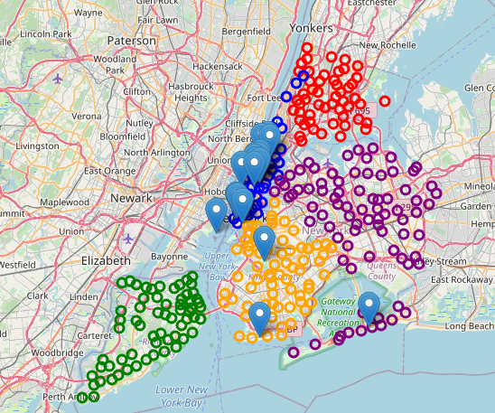
Locating top-18 tourist spots in New York
Marker | Representation
Red circle marker | Bronx
Blue circle marker | Manhattan
Orange circle marker | Brooklyn
Purple circle marker | Queens
Green circle marker | Staten Island
Blue bubble icon | Top-18 tourist spots
Most of the popular spots are in and around the blue circle markers which represent Manhattan.
Now that we were able to narrow down our search to just one Borough, which is Manhattan, the next analysis is to search for locations/neighborhoods in this particular borough having facilities such as train-stations, bus-stations and restaurants.

Slide 6
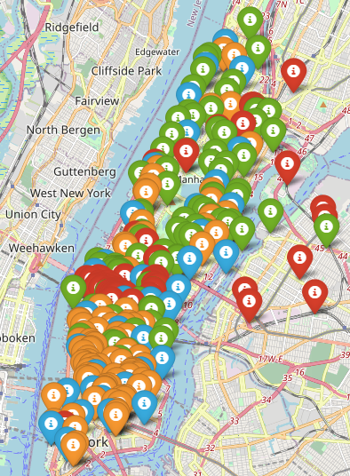
Locating bus-stations, train-stations and restaurants
The train-stations, bus-stations and restaurants are represented by icons of colors red, green and orange respectively.
The markers in blue represent the different neighborhoods.
On analyzing the figure, we could find plenty of restaurants, bus-stations and train-stations towards the south of the Central Park.
As we move towards the north, it’s mostly bus-stations and also a good number of restaurants and similar characteristics are also seen in the east and west sides of Central Park.

Slide 7
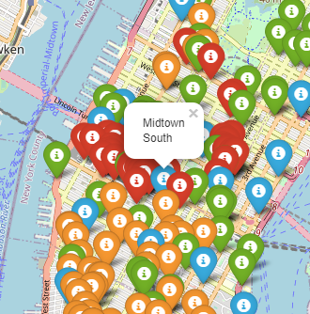
Zooming the south side of Central Park, we can observe that Midtown South has good accessibility to some nearby restaurants, train-stations as well as bus-stations compared to other locations.
Now that we have found that Midtown South is a potential location for starting out this business, let us now analyze property prices in this particular locality.

Slide 8
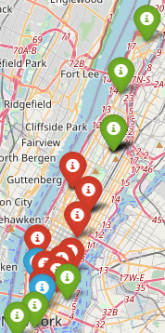
Analyzing property cost in neighborhoods of Manhattan
For this, we make use of the property sales price dataset.
Although it doesn’t have data to all neighborhoods, it can give us an expected price of a property in a certain location. For this, we use K-means algorithm to segment the neighborhoods based on the median sales price value.
A k-value of 3 was used in the analysis as we wanted to segment the neighborhoods based on low, medium and expensive categories.
The table shown below shows the price range for each group segmented using K-means and the color of markers for each group.
GROUP | PRICE RANGE
Group – 0(Red) | $3 million - $7 million
Group – 1(Blue) | $11 million - $15 million
Group – 2(Green) | $550,000 - $2 million

Slide 9
Analyzing property cost in neighborhoods of Manhattan – contd.
The neighborhoods around Central Park cost around $3 million - $7 million and the costs are less as we move towards the north where it lies between $ 550,000 and $2 million.
However in the south, as the figure illustrates, we can see some pockets where the property price exceeds $11 million and the price further reduces to $2 million and lower as we move further south to the tip.
The fairly high property price in Midtown gives us confidence about how much the locality is approved in general by the public.
In order to further prove that Midtown South is indeed a perfect option to start this service, let us explore venues around this neighborhood in a radius of 2 Km.

Slide 10
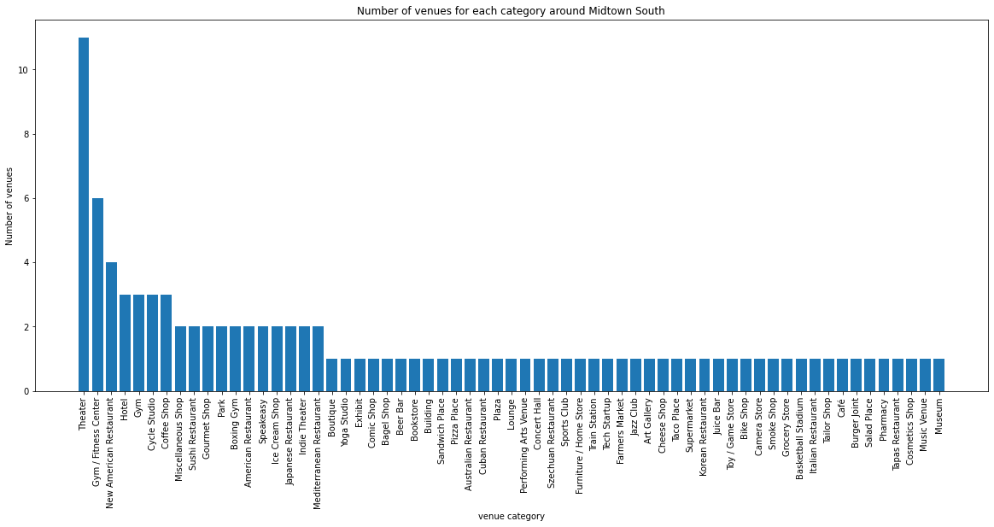
Analyzing other venues around Midtown South

Slide 11
Analyzing other venues around Midtown South – contd.
Although most of the venues are related to theatre, there are also plenty of other venues that would be useful for tourists. Along with train-station, we can notice the presence of restaurants of different cuisines including American, Mediterranean, Korean, Japanese, Italian to name a few.
The locality also has a supermarket and a pharmacy enabling tenants to buy certain essentials during their New York stay..

Slide 12
Results and Observations
Most of the top-18 tourist attractions in New York are located within Manhattan.
Since a few of them are present in the north side and the rest in the middle and south, the center of Manhattan would be an ideal location to start a hotel service.
A good number of facilities such as bus-stations, train-stations and restaurants could be found in the vicinity of Midtown South hence making it a recommended location for the hotel service.
Property prices are expected to be over $3 million.
On exploring further, a number of venues could be found near Midtown South.
Although most of the venues are for theatre, the locality also has plenty of restaurants serving a wide variety of cuisines from different parts of the world. Along with this, there are also cafes, supermarkets, pharmacies and other essential stores nearby.
Other potential neighborhoods could be Murray Hill and the Upper West Side of Manhattan.

Slide 13
Conclusion
A compelling location to start this budget friendly hotel service would be Midtown South due to its proximity to amenities such as bus-stations, train-stations and restaurants.
The presence of these facilities around the neighborhood would mean that the hotel need not provide them explicitly to the visitors and hence a major portion of the cost which incorporates meals, shuttle service to tourist spots and a part of customer service( since there are no in-person interaction with the customers ) can be slashed off which in turn would mean providing stay at a lower cost for the tourists.

